Slide 1
At the doctor's office
14. Present perfect simple and progressive

Slide 2
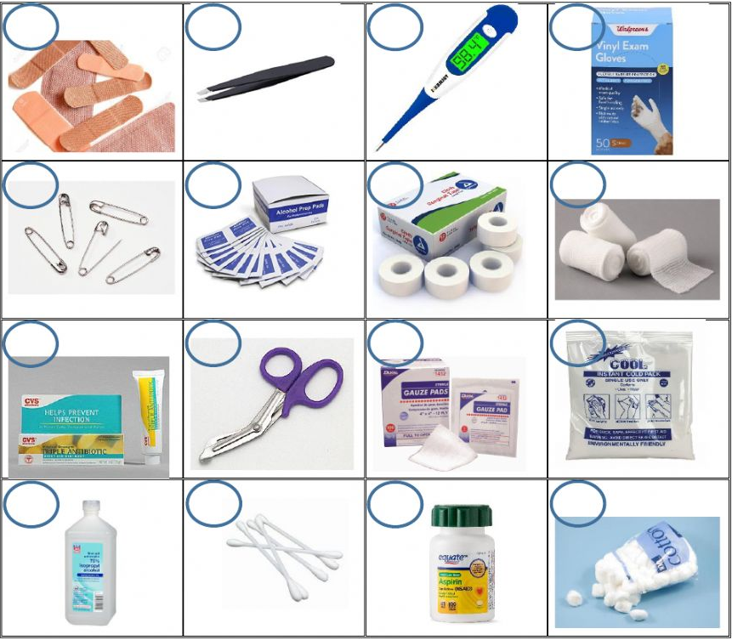
First aid kit
a
b
c
d
Thermometer
Band aids
Gauze pads
Alcohol
Medical tape
Bandages
Painkillers
Tweezers
Safety pins
Q-tips
Scissors
Gloves
Cold pack
Alcohol wipes
Cotton balls
Ointment
e
f
g
h
i
j
k
l
m
n
o
p
Notes:
1 c
2 a
3 k
4 m
5 g
6 h
7 o
8 b
9 e
10 n
11 j
12 d
13 l
14 f
15 p
16 i

Slide 3
Present Perfect Continuous
We use the Present Perfect Continuous to show that an action that began in the past is still continuing. It went on, or seemed to go on, from the moment it began until now.
She has been sleeping all day.
The nurse hasn’t been visiting the patients.
I have been waiting to see a doctor for two hours.
(?)Have you been working all day?
(+) Yes, I have.
(-) No, I haven’t.
(?)Has he been eating well?
(+) Yes, he has.
(-) No, he hasn’t.
HAVE | HAS
I | He
You | She
We | It
They
Notes:
(She started sleeping in the past. She is still sleeping at the moment.)
(The nurse began visiting the patients some time ago. She is still visiting them.)
(I am still waiting.)

Slide 4
Make positive and negative sentences
Alfred had an accident at noon yesterday. (take it easy) (work)
Alfred has been taking it easy.
Alfred has not been working.
Paula and Susan look really good. They are thinner and healthier than before. (count calories) (eat)
Kate is hot and tired. (watch TV) (work out)
The children had a fever. (play) (take rest)
Lance started calling half an hour ago. Now he is still on the phone. (try) (sleep)
We are working at the drugstore right now. We began work at 8:00 a.m. (fill prescriptions) (take time off)
Becky ate bad shrimp last night. (feel bad) (eat)
Keith went on a hike. He is inexperienced and out of shape. (walk) (enjoy)
Ariel must finish her project today, but she feels under the weather. (try) (focus)
Matt traveled to Vietnam last month. He has a weird rash on his arm. (scratch) (visit doctor)

Slide 5
Present Perfect Continuous: Questions
Wh- Questions
How long have you been working at the hospital? (For 10 years.)
Where have they been working? (In the emergency room.)
What has he been driving today? (The ambulance.)
We use Who or What to refer to the subject:
Who has been working in the emergency room? (Fred and Gloria.)
What has been happening? (There have been a lot of accidents.)
Tag Questions
He has been feeling well, hasn’t he?
She hasn’t been feeling well, has she?
You have been examining patients, haven’t you?
They haven’t been taking medical histories, have they?

Slide 6
Make questions
1. ______________________________________________?
I’ve been working at the drugstore for four years.
2. __________________________________________, ______ she?
No, she hasn’t. She hasn’t been feeling well lately.
3. ______________________________________________?
Steve has been dating Olivia.
4. ______________________________________________?
Yes, they have. They have been taking their medication.
5. ______________________________________________?
They have been filling their prescriptions at Danny’s Drugstore.

Slide 7
Make questions
6. ______________________________________________, ______ you?
Yes, we have. We have been living in New York since last December.
7. ______________________________________________?
Yes, she has. She has been taking it easy at home.
8. ______________________________________________?
Harold has been suffering from a bad infection
9. ______________________________________________?
Zack has been using the massage machine to decrease his pain.
10. ______________________________________________, _____ he?
Sadly, yes. Eugene has been working even though he has been dealing with a shoulder injury.

Slide 8
Present perfect simple vs progressive
Sometimes the Present Perfect Simple and the Present Perfect Continuous are interchangeable. But there are also some differences in meaning.
Simple | Continuous
Series of actions. How many times or how many things. I’ve worked in three sports clinics. | Continuous action. Duration of an action. I’ve been working at the sports clinic for six months.
Result of the action. Fred has already massaged the athlete. (Fred has finished massaging the athlete – the focus is on the result.) | Interested in the action whether it is finished or not. Fred has been massaging the athlete since 12:00. (Fred is still massaging the athlete – the focus is on the action.)

Slide 9
Choose the correct one
Mandy has already finished / has already been finished the acupuncture course.
Vera and Bob have gone / have been going to the gym together since they started dating each other.
I have had acupuncture four times this month / next week.
For ages ago / Since the massage, my muscles have relaxed.
We have never felt / have never been feeling so stressed before!
The athletes are tired. They have been resting all morning / three times last week.
Have you treated / Have you been treating Mr. Richards yet?
Oh my goodness! My son has lately / just had an accident! I’m going to the hospital right away.
How long have you been waiting / have you waited for the therapist? He’s very late.
George looks so bad! He has been drunk / has been drinking.
Notes:
has already finished
have been going
3. this month
4. Since the massage
5. have never felt
6. all morning
7. Have you treated
8. Just
9. have you been waiting
10. has been drinking

Slide 10

Online doctor
You have been feeling under the weather.
Send an email to your doctor explaining your symptoms.
Example:
Hello doctor _____,
I hope you are doing well. I have been feeling a bit ill. I have been getting headaches every night, and I can’t sleep because of them. I have been taking aspirins every day before bed, and they have not helped decrease the pain.
I have been working longer hours, so I have not been working out. I think that is why I have been feeling unwell.
Can I schedule an appointment for tomorrow at 10am?
Thanks, (your name).

